Slide 1
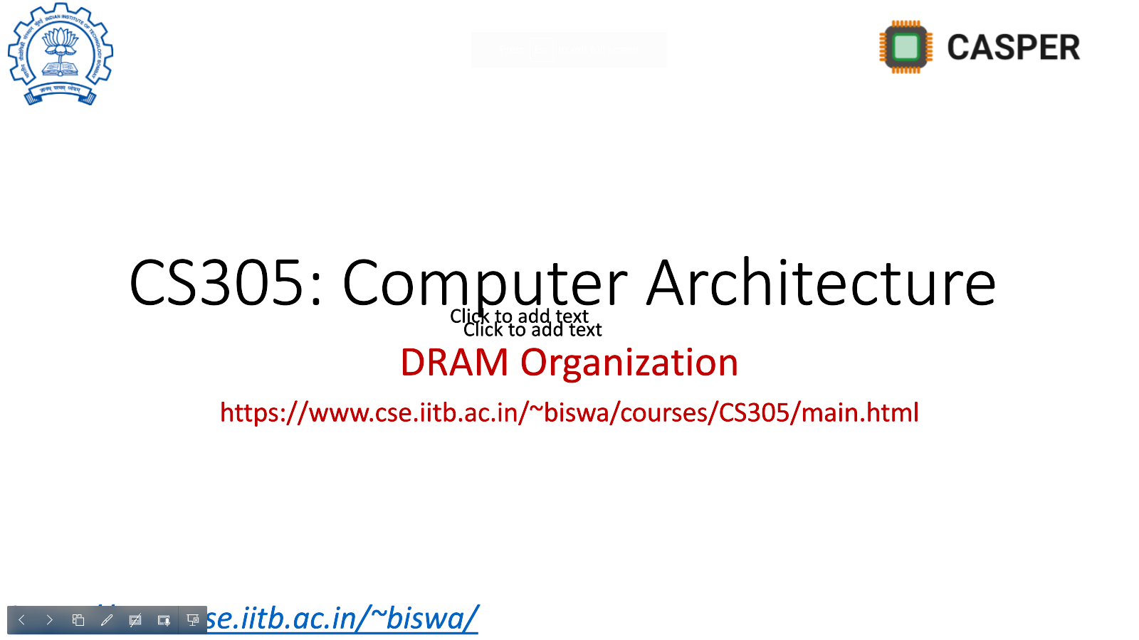
Seminar A study of Last-level cache management techniques, prefetching and their interactions
Sumon Nath(21q050007) guided by Prof. Biswabandan Panda sumon@cse.iitb.ac.in

Slide 2
Outline
Problem
LLC management techniques
Hardware prefetching
Prefetching techniques
Interaction between the two
Conclusion

Slide 3
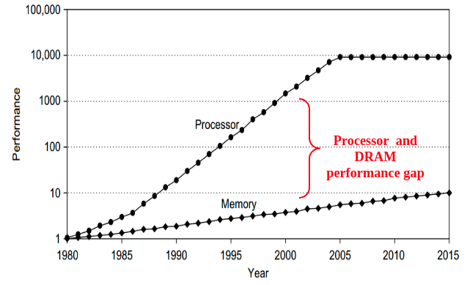
Problem
55% growth rate
10% growth rate
Notes:
New plot

Slide 4

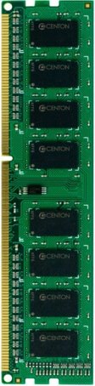
Problem: Memory wall
CORE
DRAM Controller
100’s of cycles

Slide 5
Latency tolerance techniques
Out-of-order execution
Multithreading
Caching
LLC Management techniques
Cache Prefetching

Slide 6
Up next …
Problem
LLC management techniques
Hardware prefetching
Prefetching techniques
Interaction between the two
Conclusion

Slide 7
LLC Management
Ways
High priority
Low priority
A
B
C
D
Priority chain
Eviction: Victim
Sets
Decisions:
Insertion - priority of new block
Promotion(hit) - updated priority
…
Last level cache

Slide 8
Textbook: LRU
Insert : new block to MRU
MRU
LRU
Assumption:
new block will be
re-referenced soon
D
A
A
B
C
Promote (on hit) : LRU to MRU
Evict: block at LRU position
Works only for cache friendly workloads
MRU
LRU
D
A
B
C
C
D

Slide 9
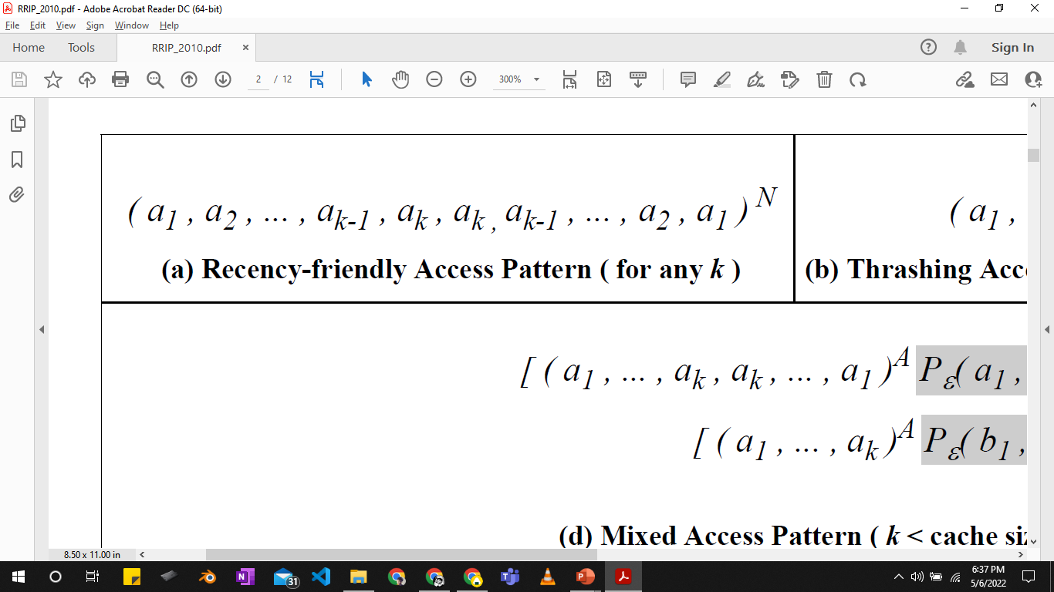
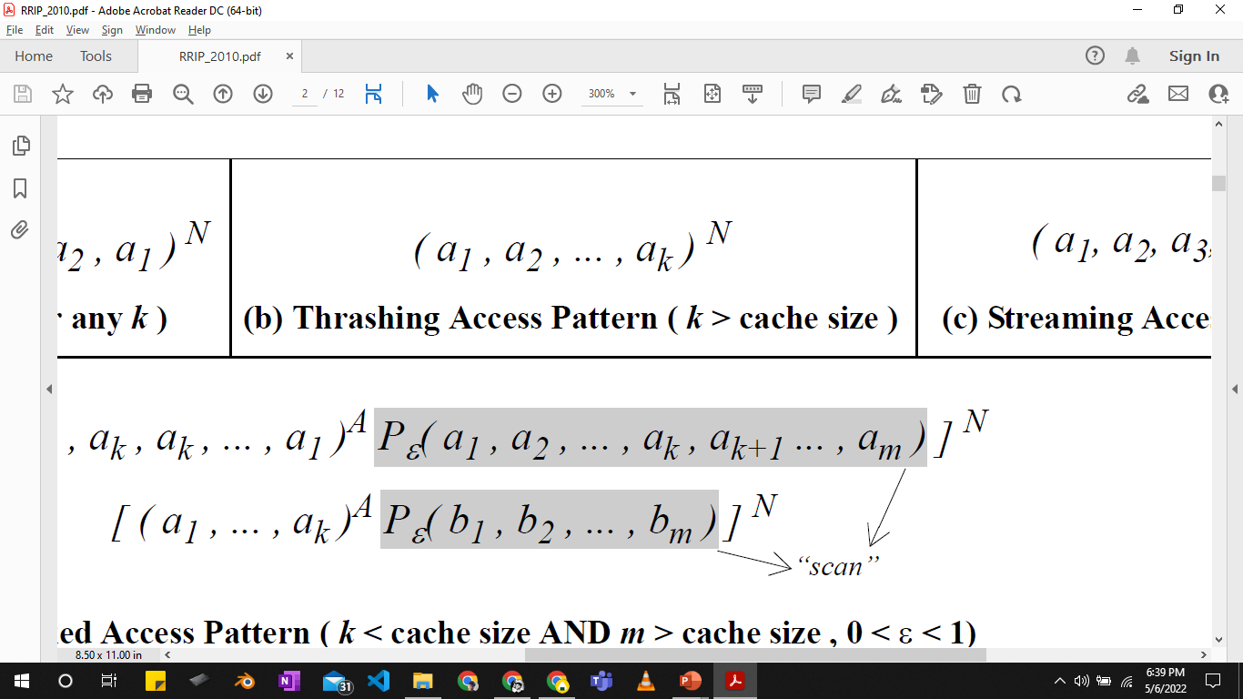
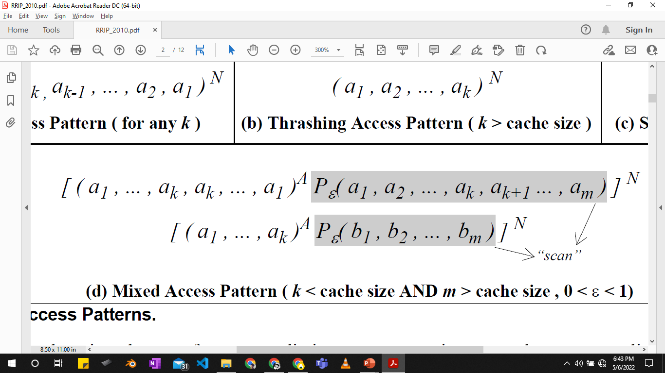
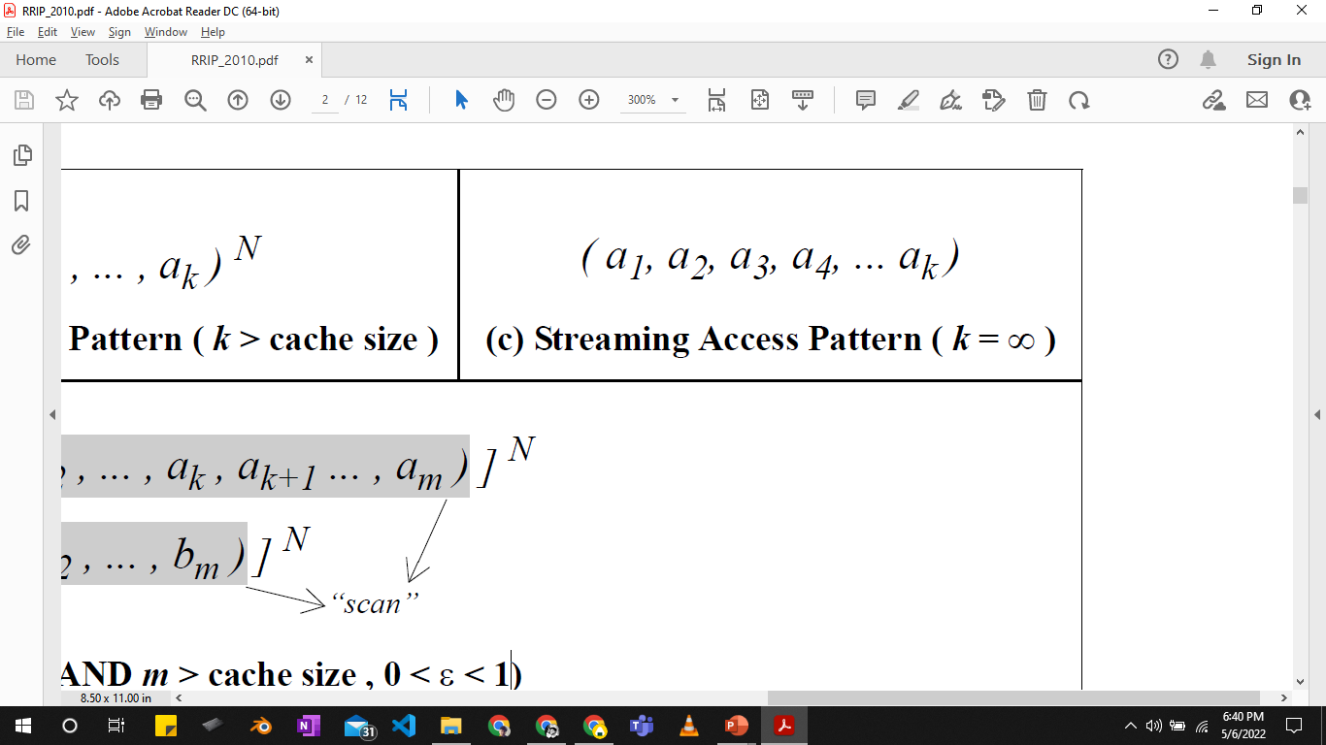
Access patterns
Recency friendly
, k < cache size
LRU gets max. hits
Thrashing
, k > cache size
Scanning
(Non-temporal data)
Scan
Streaming
, k =∞
Notes:
Example of access patterns

Slide 10
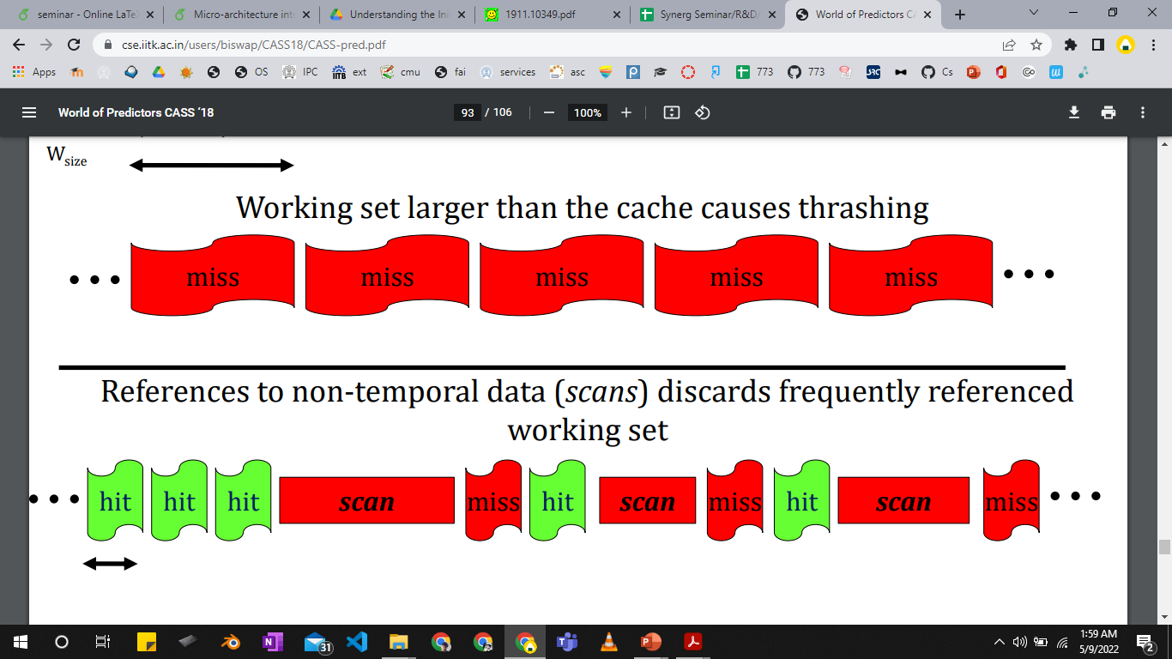
Access patterns
figure adapted from Prof. Biswa’s slides

Slide 11
Re-reference interval prediction [ISCA ‘10]
RRP head
RRP tail
A
E
F
G
H
A
B
C
D
D
Reuse
prediction
near-
immediate
(0)
intermediate
(1)
far
(2)
distant
(3)
Insert : new block with RRPV=2/3
Promotion: update RRPV to 0
Eviction: block with RRPV=3
Assumption:
new block will not be
re-referenced soon

Slide 12
RRIP variations
Scan resistant
Thrash resistant
Static-RRIP
Insert with RRPV = 2
Discards scans quickly
Preserves cache friendly accesses
Bimodal-RRIP
Insert with RRPV=2/3 probabilistically
Preserves blocks in a thrashing workload
Set-dueling
mechanism
Selects winning policy
Dynamic-RRIP: dynamically adapts to active workload

Slide 13
SHiP [MICRO '11]
Signature
PC
Memory region
Updates counter on hits
Predicts RRPV of new blocks with same signature
counter
A
####
Signature history counter table
LLC
Improves RRIP accuracy by correlating blocks with same signature

Slide 14
Problem with RRIP
Operate based on heuristics
Specific to certain workloads
Fail in case of more complex access patterns
Different approach: mimic Belady’s optimal policy

Slide 15
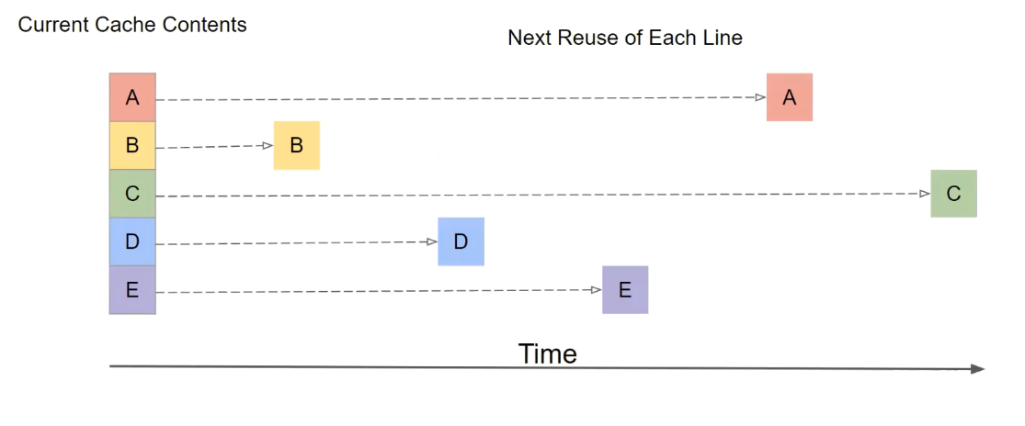
Optimal technique - Belady

Slide 16
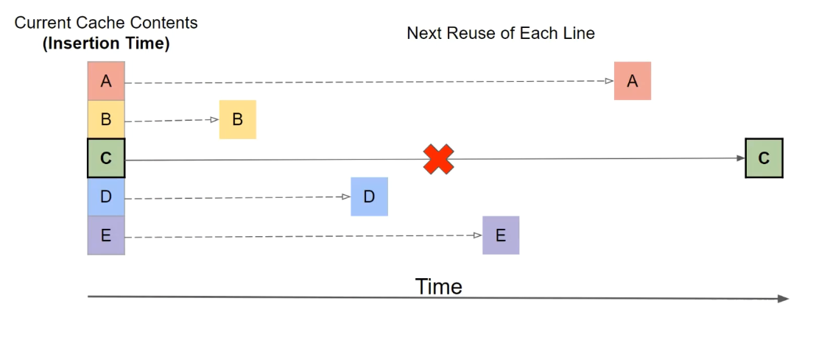
Optimal technique - Belady
Not practical
Goal: Evict block used furthest in future

Slide 17
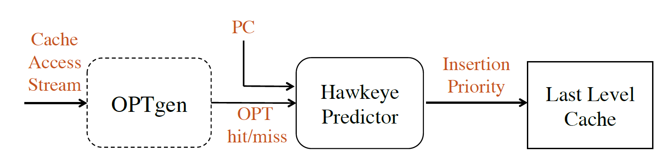
Emulating Belady: Hawkeye [ISCA '17]
Emulates Belady’s MIN policy
Learns from OPTgen’s decisions
Cache friendly
Prediction
Cache averse
figure taken from Hawkeye paper
Binary classification

Slide 18
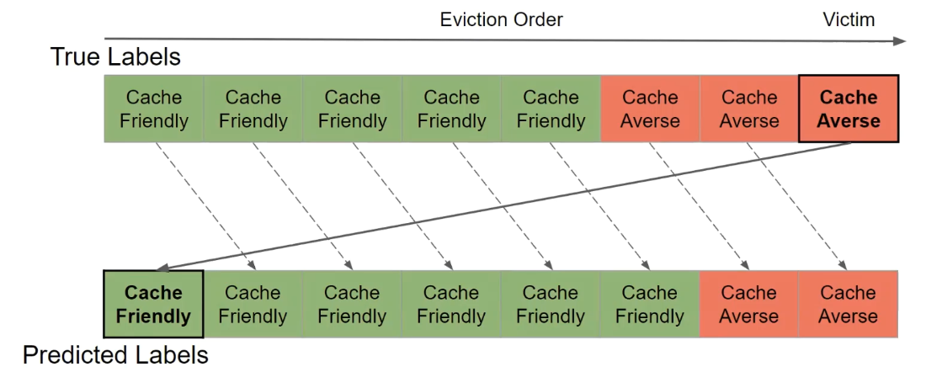
Binary classification problem
figure taken from Mockingjay paper
Misprediction-> high impact

Slide 19
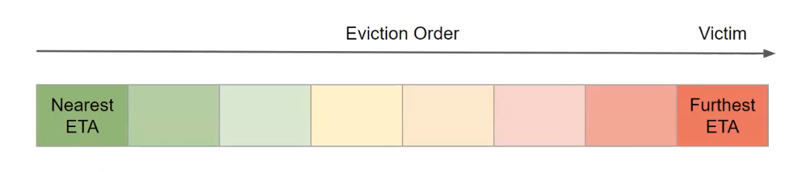
Multiclass : Mockingjay [HPCA 2022]
Emulates Belady’s policy on past accesses
Predicts estimated time of arrival (ETA)
figure taken from Mockingjay paper

Slide 20
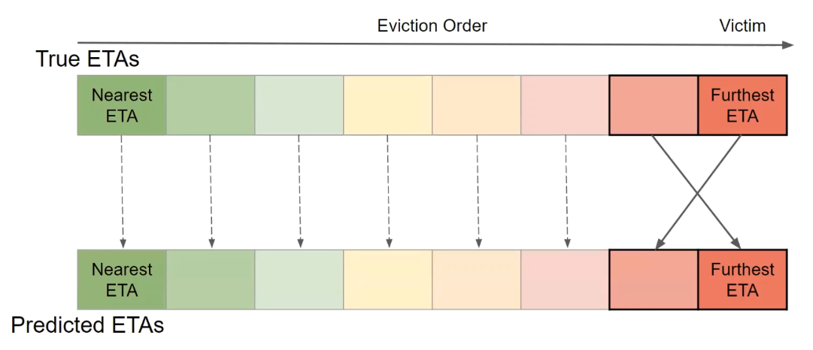
Multiclass misprediction
figure taken from Mockingjay paper
Misprediction-> low impact

Slide 21
Techniques employed
LLC Management techniques
Textbook
Emulates Belady
Intel
LRU
DRRIP
SHiP
Hawkeye
Mockingjay
Increasing complexity
Increasing performance
Notes:
references

Slide 22
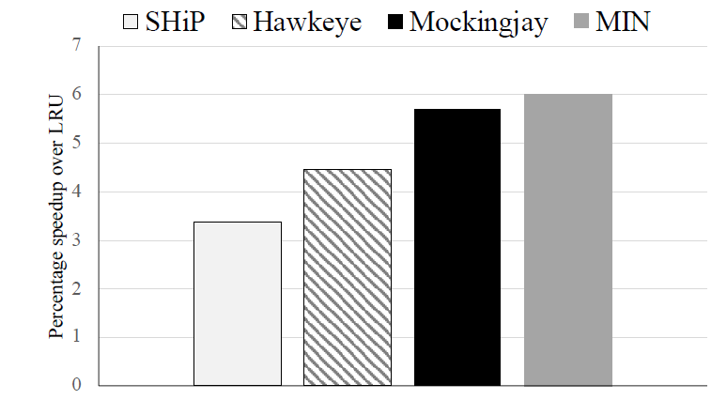
Comparison of techniques (single core)
Belady
figure taken from Mockingjay paper
Mockingjay speedup - 5.5%, close to 6% of Belady’s optimal
Notes:
references

Slide 23
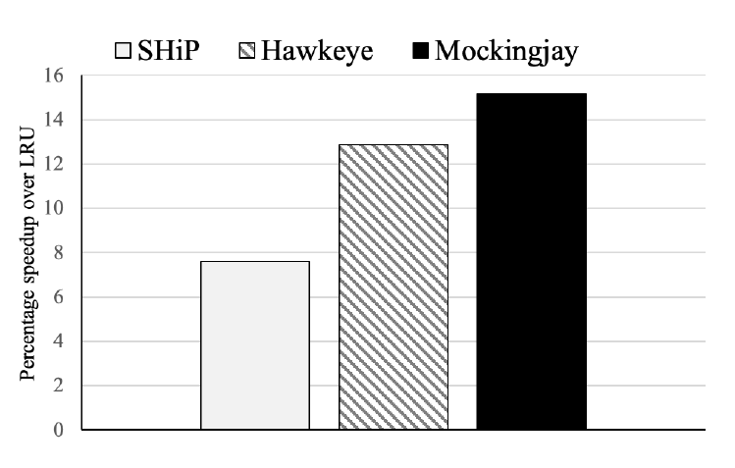
Comparison of techniques (4-core)
figure taken from Mockingjay paper
Mockingjay best performing technique with 15.2% speedup

Slide 24
Up next …
Problem
LLC management techniques
Hardware prefetching
Prefetching techniques
Interaction between the two
Conclusion

Slide 25
Hardware Prefetching
HIT
X + 3
3
X + 3
5
CORE
Cache
data
4
X + 2
X + 1
X
X + 3
1
Prefetcher
2

Slide 26
Metrics of interest
Accuracy
Used prefetches / total prefetches
Coverage
Misses eliminated by prefetching / total misses
Timeliness
How early/late a prefetch is?
DRAM bandwidth consumption
Cache pollution - unused prefetches

Slide 27
Up next …
Problem
LLC management techniques
Hardware prefetching
Prefetching techniques
Interaction between the two
Conclusion

Slide 28
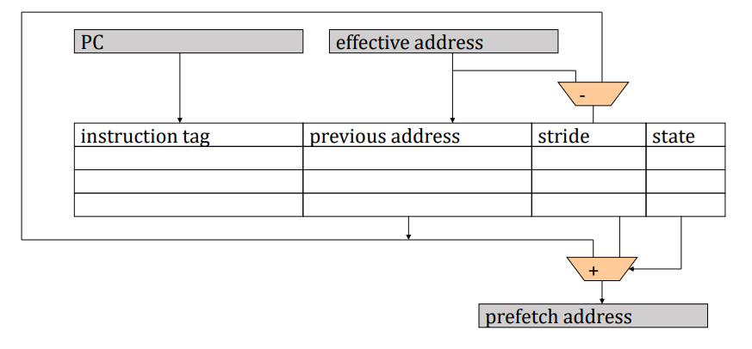
Intel's Stride prefetching
Associates Instruction pointer(IP) to a constant stride

Slide 29
Stride patterns
+1, +1, +1,…
+3, +3, +3,…
Constant Stride
+1, +2, +1, +2…
+1, -3, +4, +1, +1, -3, +4, +1…
Complex Stride

Slide 30
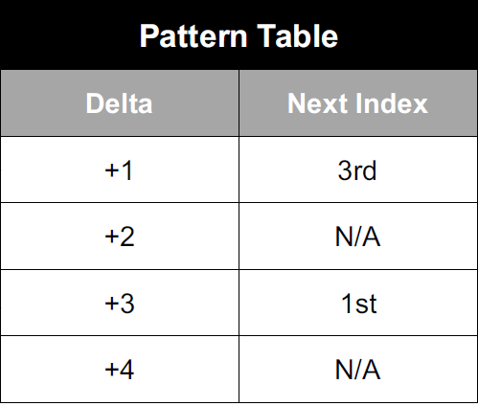
Look-ahead based: SPP [MICRO 16]
Prefetch with P%
Access
(signature)
Lookahead prefetch(P’%)
+1, +3, +1, +3…
Can handle more complex strides
figure taken from SPP paper
Notes:
Signature contains the strides

Slide 31
Offset based: BOP [HPCA 16]
Prefetch address
Trigger address
X
X + D
Offset
D
Finds optimal offset D for prefetches
Dynamically updates D with changing app. behavior
Best offset learning
test di
Recent prefetch requests
X
test di+1
If X-d present: increase confidence
Outcome: Timely prefetches
Notes:
Simple technique with very low hardware cost

Slide 32
Region based: Bingo[HPCA 19]
Records spatial access pattern over a memory region (eg. OS page)
Pattern history table
Spatial pattern
100111011001
Trigger access
PC
PC + address
PC + offset
001100101000
100110110001
Prefetch:
X+2
X+3
…
Very aggressive in nature
Notes:
Significant hardware overhead

Slide 33
Prefetching techniques
Hardware prefetchers
Stride based
Lookahead based
Hybrid
Region based
IP-stride
IPCP
[ISCA ‘20]
VLDP
[MICRO ‘16]
SPP
[MICRO ‘16]
Bingo
[HPCA ‘19]
SMS
[ISCA ‘06]

Slide 34
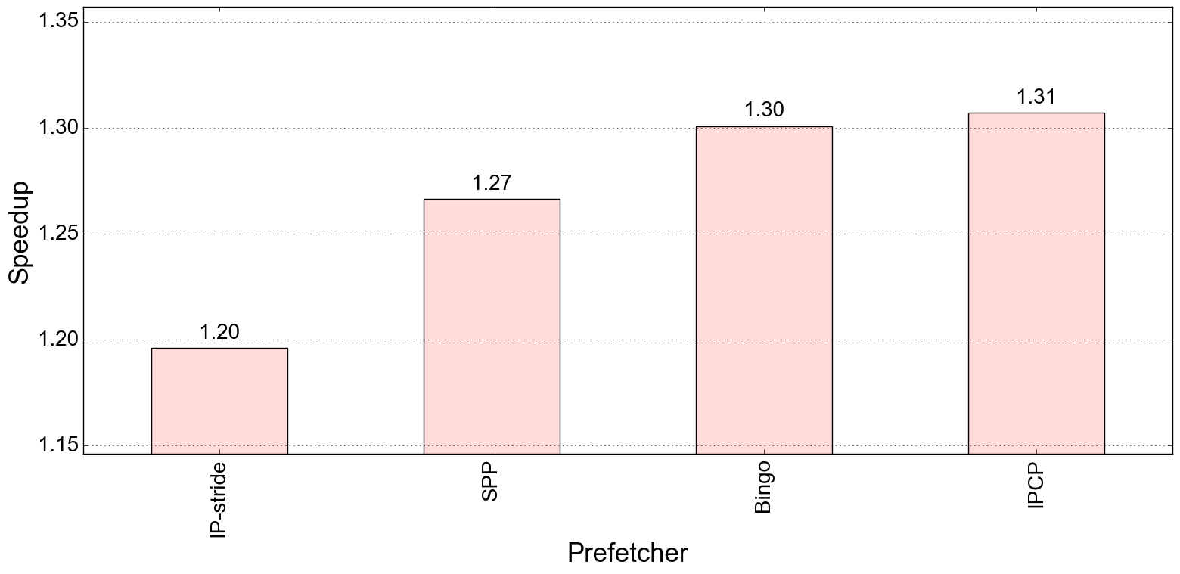
Comparison of prefetchers
Baseline: no prefetching
As high as 31% improvement in single core system
Notes:
basline

Slide 35
Up next …
Problem
LLC management techniques
Hardware prefetching
Prefetching techniques
Interaction between the two
Conclusion

Slide 36
Interaction (More on RnD)
Cache
Decides which blocks to retain
Decides which blocks to prefetch
Management techniques
Interact
Prefetchers
Communicate

Slide 37
Interaction (More on RnD)
Prefetch aware cache management [MICRO 2011]
Modifies RRIP to adapt to prefetching
Kill the PC [ASPLOS 2017]
Co-operative prefetching & caching scheme
Harmony [ISCA 2018]
Modifies Belady’s optimal policy to accommodate prefetching

Slide 38
Conclusion & future work
LLC management techniques are key to performance
Reached optimal performance threshold
Hardware prefetchers improves performance by many folds.
Need to study the interaction between the two to further improve performance, bandwidth, and energy consumption for single and multi-core systems

Slide 39
Thank You Any Questions

